Slide 1
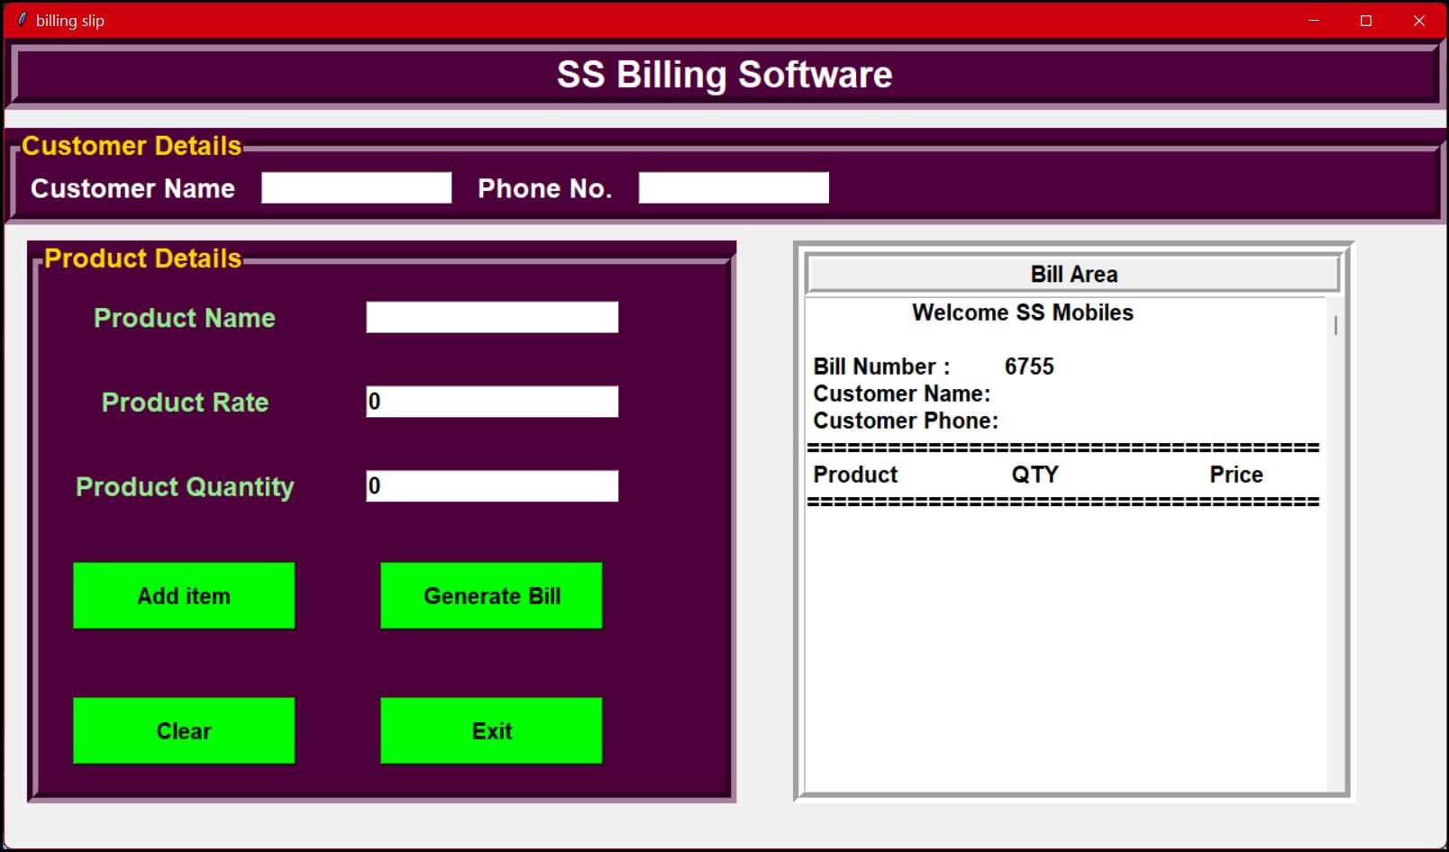
WELCOME TO OUR MINI PROJECT
OUR TEAM : 1) SHUBHAM SAGAR
2) TUKARAM BHALERAO
3) SIDDESHWAR HOTGE
4) MAYUR PATIL
5) VIRESH JAMMA

Slide 2
Agenda/Topics to Be Covered
Introduction
Types of EBS and Parties involved in it
DFD for EBS
ER Diagram for EBS
Why to use EBS?
Advantages/Applications of EBS
Conclusion

Slide 3
INTRODUCTION
Electronic billing or electronic bill payment and presentment, is when a seller such as company, organization, or group sends its bills or invoices over the internet, and customers pay the bills electronically. This replaces the traditional method where invoices were sent in paper form and payments were done by manual means such as sending cheques.
The development of electronic billing and payments started in the late 20th century, and whilst its exact origins are unclear, it is generally agreed that development of electronic billing coincided with the rise of the Information Age. It went hand in hand with the development of internet banking, introduction of accounting software and widespread use of email.
In the United States, the Council for Electronic Billing and Payment of the National Automated Clearing House Association (NACHA) is credited with broadly promoting and communicating various forms of electronic billing in the early 2000s. NACHA promoted activities and initiatives that facilitated the adoption of electronic payments in the areas of Internet commerce, electronic bill payment and presentment, financial electronic data interchange (EDI), international payments, electronic checks, electronic benefits transfer (EBT) and student lending. Certain electronic billing applications also provide the ability to electronically settle payment for goods or services.

Slide 4
TYPES OF EBS AND PARTIES INVOLVED IN IT
Biller-direct – where consumers make payments directly to one biller that issues bills that they receive at the website of the firm that issued the bill. An example would be of a public utility company offering this payment service to its consumers. A market has emerged for outsourced billing providers who specialize in electronic billing processes and technology for companies that need to send bills directly to their customers.
Bank-aggregator – where a payment is made at an aggregator or consolidator site, usually from a consumer's bank's website. This model allows the consumer to make payments to multiple billers that are pre-registered to receive payments. Examples are One-Vu in the UK and e-Bill in Switzerland.
Billers, bankers, aggregators and consolidators can play various roles in the overall process. Once roles are defined, it is easier to identify which model is most appropriate for the client's strategy. Billers may also implement more than one model in order to best serve their clients. Because the industry is continuously changing and redefining, the options and opportunities will continue to expand.
Biller payment provider (BPP) – An agent of the biller that accepts remittance information on behalf of the Biller.
Biller service provider (BSP) – An agent of the biller that provides the service for the Biller.
Consolidator – A biller service provider that consolidates bills from multiple Billers or other bill service providers (BSPs) and delivers them for presentment to the customer service provider (CSP).
Customer service provider (CSP) – An agent of the customer that provides an interface directly to customers, businesses or others for bill presentment. CSP enrolls customers, enables presentment and provides customer care, among other functions

Slide 5
DFD for EBS : ZERO LEVEL
Stock Management
Product Management
Store Management
Electronic Billing System
Customer Management
Product Quality Management
Bill Management

Slide 6
DFD FOR EBS : FIRST LEVEL
Stock Management
Generate Stock Report
Product Management
Generate Product Report
Electricity Billing System
Product Quality Management
Generate Product Quality Report
Bill Management
Generate Bill Report
Customer Management
Check Customer Details
Store Management
Generate Store Report

Slide 7
DFD FOR EBS : SECOND LEVEL
Login to System
Manage Stock Details
Check Roles of Access
Admin
Manage Product Details
Forgot Password
Manage Product Quality Details
Check Credentials
Manage Module’s
Manage Bill Details
Send Email to User
Manage Customer Details
Manage Store Profiles
Manage System Admins
Manage Roles of User
Manage User Permission
Manage Login Report

Slide 8
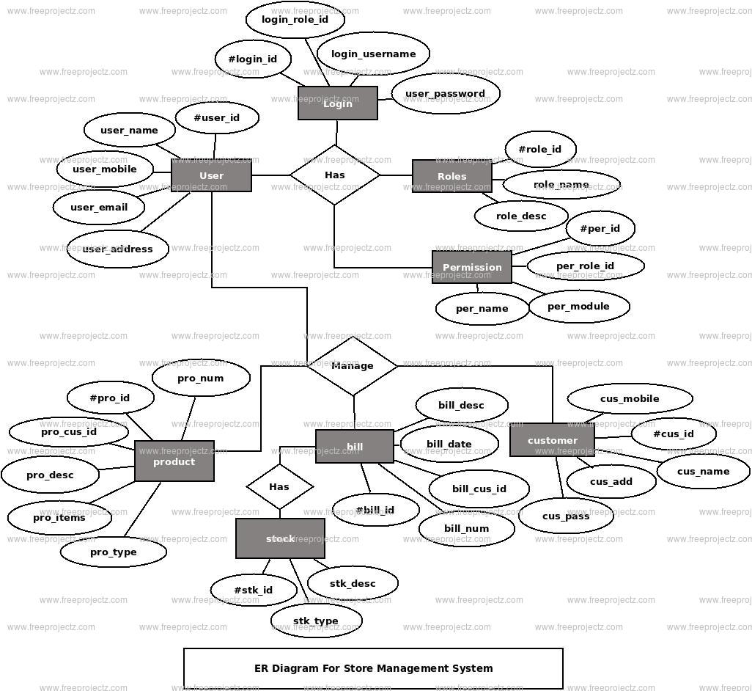
ER DIAGRAM FOR EBS

Slide 9
WHY WE SHOULD USE EBS?
1. Simple and Easy Organization of payments
2. Easy consolidation of Finances
3. It is Eco-friendly
4. Allowing Credit Cards
5. Fast, Easy and Safe

Slide 10
ADVANTAGES OF EBS
Saving time & cost
Easy access to information
Integration of different aspects
Organized processes
Overall customization
Remembers to remind you

Slide 11
CONCLUSION
This coursework has helped me to explore more in python programming language. I learnt that python programming is a great degree valuable apparatuses to manufacture and create many projects and programming. The stock administration framework is valuable as it keeps the record of the item in the electronic store and in addition it causes client to screen their buy.
Similarly, it has helped me to achieve the new level of the imagination and have given me the certainty to grow more projects and to improve my programming abilities and skills as well as to improve my programming understanding level. After a great deal of diligent work and research, at long last calculation and flowchart were made which would give the peruse a basic perception of the program, clear comprehension of the code and how the program is running. After the consummation of the coursework it was important to guarantee that it was bug and mistake free, such a significant number of test were done which affirmed that the projects were prepared to use in the genuine situation and can be refreshed if necessary in future.
From the overall coursework, it gives me a knowledge about not only python programming language, flowchart and pseudocode also helps to Java programming language as well. This coursework is quite tough then I expect, In the first week of this coursework I feel it is easy to create a program as a requirement. But , this is hard to finish. Finally, it happens good and program is also done with the help of teachers as well as senior friends.
Hence indisputably, the coursework has been an amazing help to learn and get the more information about the python programming language. Moreover, it has helped me in additionally creating distinctive different ability and educated numerous things which will help in my profession life in future. This undertaking has still got spaces for the change. At long last, I foresee accomplishing more undertakings in coming future

